Slide 1


Institute Billing System
By
Santosh Bhandari
Tikaram Parajuli

Slide 2

Introduction
Web-Based Application that address Billing Process
Designed to Address Billing Process
Reduce Manual Billing Method
Keep a record of Payment and Improve transparency

Slide 3


Problem Statement
Invoices are generated manually
Complex and Time-Consuming to Track Payment Information

Slide 4
Objectives
To Generate Computerized Invoice.
To Keep a record of Payments, Invoices, Student Information

Slide 5
Requirement Analysis
Functional Requirement
Login & Logout
Manage Student
View & Manage Bill
Manage Course
Manage Admin

Slide 6
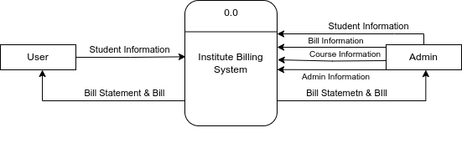
DFD
Level 0 DFD

Slide 7
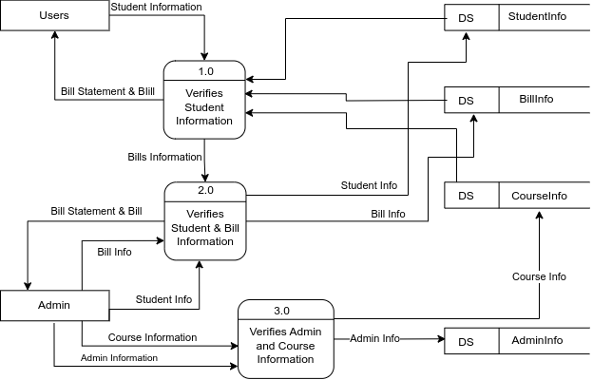
DFD
Level 1 DFD

Slide 8
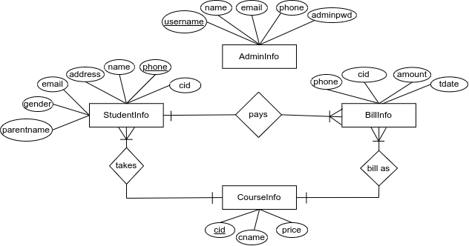
ER Diagram

Slide 9
Conclusion
The Institute Billing System iscreated to modernize the billing process, replacing traditional methods. The key goals is to generate computerized invoices, efficient payment tracking, and maintaining student records. With the successful development of the system, it has achieved all these predefined objectives. It now generates invoices and effectively track payment information and keep student records.

Slide 10
Thank You

